Slide 1
MONDAY do now
In your English Notebook, make a list of your favorite video games/game series.

Slide 2
Recent games that mr. Abe has bought
Destiny
Grand Theft Auto V
Dragon Age Inquisition
Farcry 4
The Last of Us Remastered
What do these games have in common?

Slide 3
VIdeo games-
GOod or bad?
Desensitization:
The diminished emotional responsiveness to a negative stimulus after repeated exposure to it
When a person has smaller and smaller reactions to something negative after becoming used to it

Slide 4
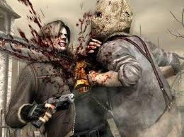
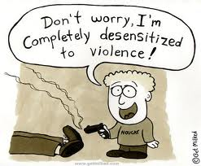
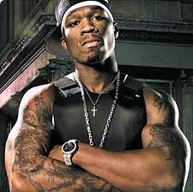
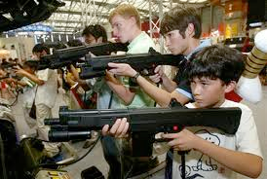
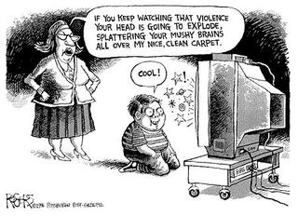
Desensitization

Slide 6
TUESDAY DO NOW
In your English notebook, respond to the following question.
What procedures do we need to follow when we have a class discussion?

Slide 7
Socratic Seminar
Does Ender like Battle School?

Slide 8
Socratic Seminar
Did Ender mean to really hurt Stilson and break Bernard’s arm? What do these incidents tell us about Ender?

Slide 9
Socratic Seminar
Explain whether or not it is acceptable to do despicable things for survival.

Slide 10
Socratic Seminar
Why do people bully? Why do people follow bullies?

Slide 11
Socratic Seminar
What do video games teach children? Should violent video games be banned? Explain.

Slide 12
CLASS ARMY AND TOONS
Now that Ender has been assigned his first army, it is time for us to name our class army and choose our roles.

Slide 13
Toon ROLES
Today, each toon is going to choose people to be/do the following:
Toon leader (scribe, spokesperson, etc.)
Collect homework and give it to homework picker upper
Pick up and return books
Pick up assignments from counter

Slide 14
CLASS Army Name
Each English class in 7th grade will be commissioned as its own army
Each Army needs a Name (Animal) and Logo
This name CANNOT be from the book
Each Toon has the remainder of the period to pick a name and design a logo.
We will vote on a final name at the end of the period

